Slide 1
Netw310
Wired, Optical and Wireless comms
Samuel depriest
www.github.com/samangelde

Slide 2
Index
Baseband signals and AM/FM signals
Pulse code modulation and Line codes
Cables and cabling
Antenna Gain and free space path loss
Bit error rate of fading channels

Slide 3
What was learned
and analyze the signal spectra of popular line coding techniquesWe learned how to complete objectives and operate tools using guides and Labs. This included using a Oscope and a spectrum analyzer for analyzing the time-domain and frequency domain of a square wave signal, basic building blocks of a PCM codec, current network cabling installation standards used in structured cabling systems for multimedia communications. Reference the ANSI/TIA-568 and ISO/IEC 11801 structured cabling standard, analyzing the relationship between the signal frequency, antenna size, and antenna gain as well as analyzing the relationship between the signal frequency, distance, and free space path loss, exploring and analyzing the BER performance of wireline and optical channels that use FSK, PSK, and DPSK as well as exploring and analyzing the BER performance of wireless channels that use PSK

Slide 4

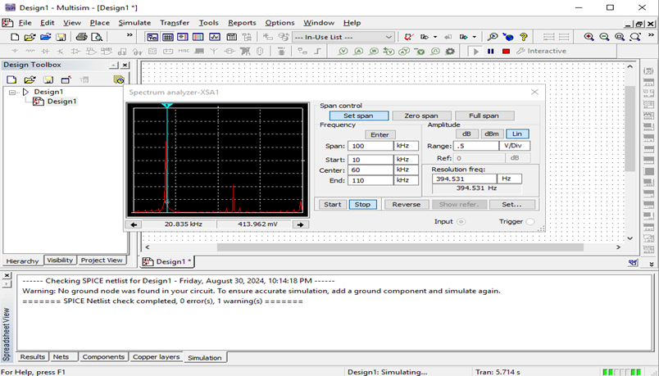
Baseband signals
And AM/FM signals
The screenshot shows the spectrum analyzer displaying the signal’s harmonic spectrum and its panel settings

Slide 5
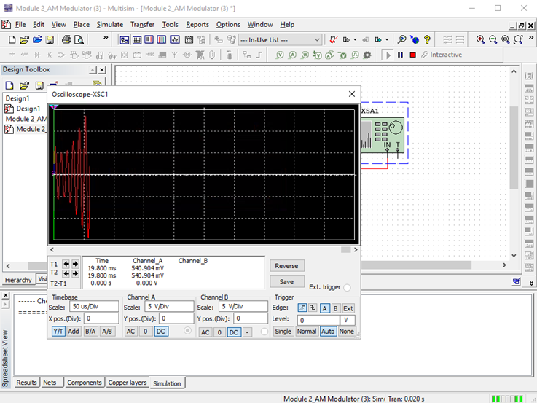
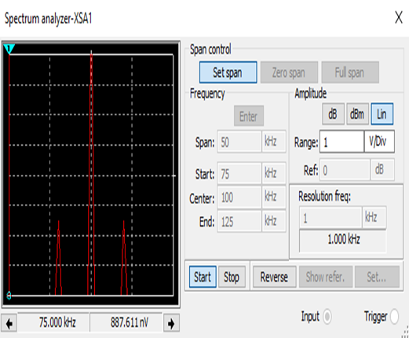
Baseband signals
And AM/FM signals
The screenshot of the Oscilloscope includes the signal and the panel settings of the oscilloscope. The screenshot of the Spectrum Analyzer also includes the signal and the panel setting of the analyzer.

Slide 6
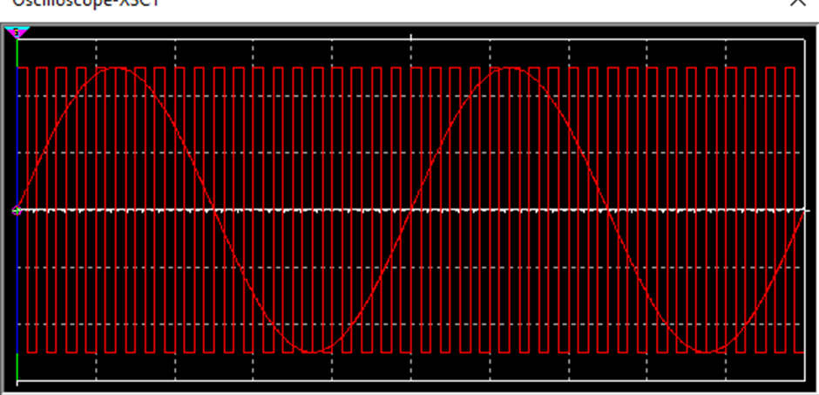
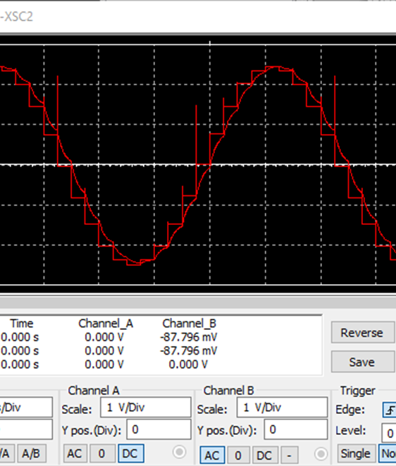
Pulse code modulation
The first screenshot shows the Oscilloscope-XSC1 display with the analog input signal and sampling clock at the input to the ADC. The second screenshot shows the Oscilloscope-XSC2 display with the output of the DAC.

Slide 7
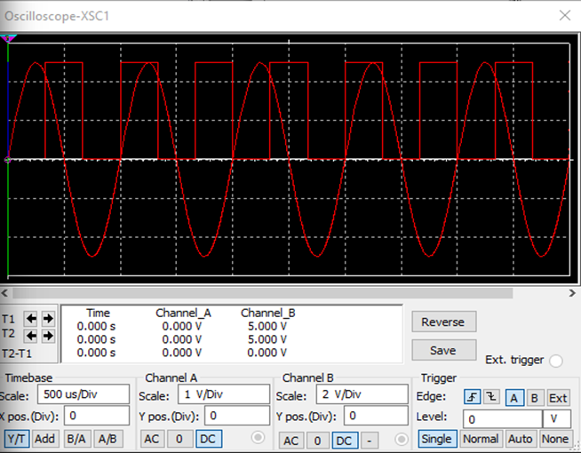
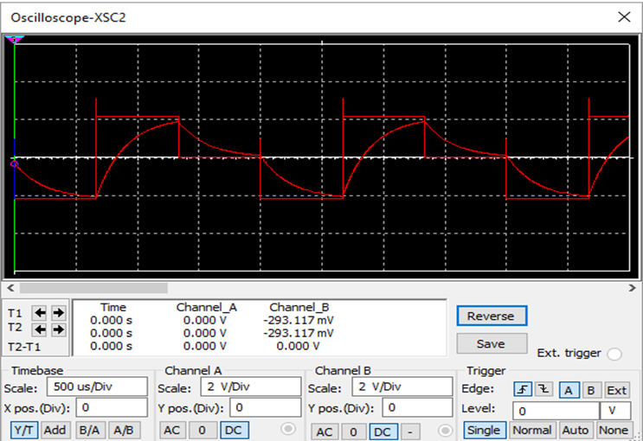
Pulse code modulation
The first screenshot shows the Oscilloscope-XSC1 display with the analog input signal and sampling clock at the input to the ADC. The second screenshot shows the Oscilloscope-XSC2 display with the output of the DAC.

Slide 8
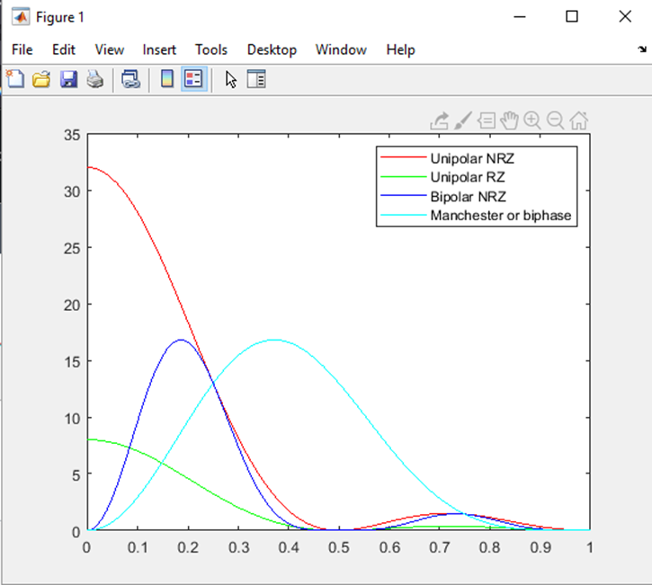
Line code
This screenshot shows the power spectral densities of four-line codes: NRZ-Polar, NRZ-Unipolar, NRZ-Bipolar, and Manchester-Polar.

Slide 9
Cables and cabling
We learned about the types of cable and terms for cabling that follow in the standards for tia 568, iso11801, en 50173.

Slide 10
Antenna gain and free space loss
We used the website http://www.swisswireless.org/wlan_calc_en.html to calculate for antenna gain and free space loss using size of dishes, and distance from the antenna.

Slide 11
Bit error rate fading channels
We used matlab to launch the bertool (bit error rate) which is an analysis tool and compared different types like awgn-fsk, awgn-psk, awgn dpsk, Rayleigh-psk,rician-psk. We figured out that the awgn out performs the rician channel consistently.

Slide 12
Career skills gained
Understanding how oscopes and spectrum alanlyzers work with working with communications equipment
Being able to calculate for free space loss and antenna gain
Learning the materials relating to codes that to follow proper standards. The materials used and why those specific ones are.
Understanding and calculating for bit error rate and fading channels

Slide 13
conclusion
This was an informative class that taught me a lot I did not know when it comes to comms. I enjoyed this class very much and believe that it will benefit my career.

